Slide 1
Oracle certified Java associate
Lesson 16
Andrei Dragutan

Slide 2
Recap:
What are the OOP principles?

Slide 3
2 parts
Polymorphism
Quiz
Practice

Slide 4

Polymorphism - definition
•The term polymorphism literally means "having many forms"
•A polymorphic reference is a variable that can refer to different types of objects at different points in time
•The method invoked through a polymorphic reference can change from one invocation to the next
•All object references in Java are potentially polymorphic

Slide 5
Polymorphism - definition
•Suppose we create the following reference variable:
Occupation job;
•Java allows this reference to point to an Occupation object, or to any object of any compatible type
•This compatibility can be established using inheritance or using interfaces
•Careful use of polymorphic references can lead to elegant, robust software designs

Slide 6
Polymorphism - definition
Polymorphism = “many forms”
E.g. a developper is a developper a developper is an employee => We can refer to a developper by both:
developper
employee

Slide 7
References and Inheritance
•Assigning a child object to a parent reference is considered to be a widening conversion, and can be performed by simple assignment
•Assigning a parent object to a child reference can be done also, but it is considered a narrowing conversion and must be done with a cast
•The widening conversion is the most useful

Slide 8
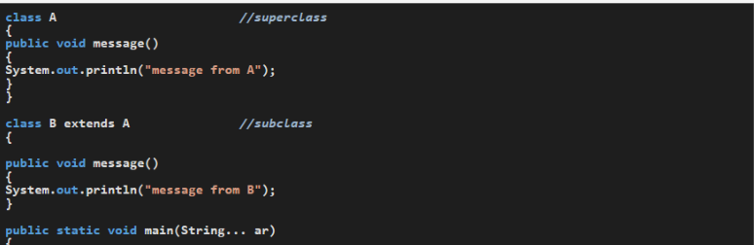


Narrowing and widening
p

Slide 9
Polimofism with inheritance
•An interface name can be used as the type of an object reference variable Speaker current;
•The current reference can be used to point to any object of any class that implements the Speaker interface
•The version of speak that the following line invokes depends on the type of object that current is referencing
current.speak();

Slide 10
Polymorphism - definition
Reffering to a type (class) by it’s super type (class)

Slide 11
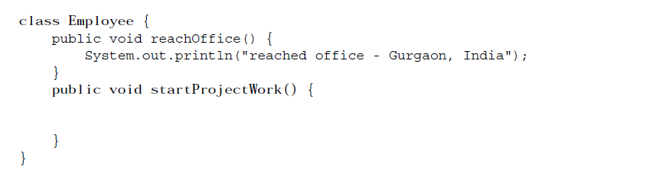
Polymorphism - example (base class)

Slide 12
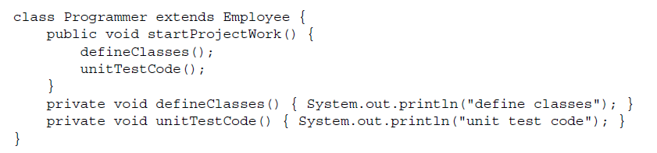
Polymorphism - example (child class)

Slide 13
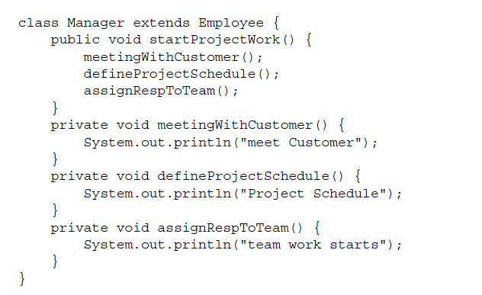
Polymorphism - example (another child class)

Slide 14
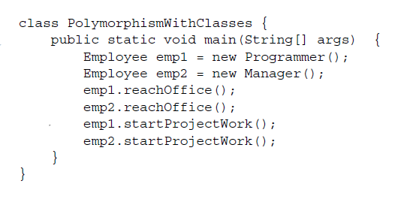
Polymorphism - example (app)

Slide 15
Polymorphism - benefits
Ability of an object to behave in its own specific manner, when the same action is passed to it.

Slide 16
Polymorphic methods
Polymorphic methods are often called overriden methods.
Rules for overriding the methods:
Methods should be defined in the classes that share inheritance relationship.
Same signature
Return type can be the same or a sub-class of the original return type.
Derived class can override only non-final methods
For overriding method access modifier can be the same or less restrictive than the overriden one. It cannot be more restrictive.

Slide 17
Methods should be defined in the classes that share inheritance relationship
class Person {
void run() {
}
}
class Manager {
void run(){
// method code
}
}
Notes:
In order for us to say that Manager run() method overrides the Person’s one, Manager should extend from Person.

Slide 18
Same signature
class Person {
void run() {
// method code
}
}
class Manager extends Person {
void run(String shoesType){
// method code
}
}
Notes:
In order for us to say that Manager run() method overrides the Person’s one, in the Manager class, run should have the same signature.

Slide 19
Return type can be the same or a sub-class of the original return type.
class Person {
Person run() {
// method code
}
}
class Manager extends Person {
String run(){
// method code
}
}
Notes:
In order for us to say that Manager run() method overrides the Person’s one, run() should return either Person or a Manager.
class Manager extends Person {
Manager run(){
// method code
}
}
///-----------------------------
class Manager extends Person {
Person run(){
// method code
}
}

Slide 20
Return type can be the same or a sub-class of the original return type.
class Manager extends Person {
Manager run(){
// method code
}
}
///-----------------------------
class Manager extends Person {
Person run(){
// method code
}
}
Notes:
In order for us to say that Manager run() method overrides the Person’s one, run() should return either Person or a Manager.
class Manager extends Person {
Manager run(){
// method code
}
}
///-----------------------------
class Manager extends Person {
Person run(){
// method code
}
}

Slide 21
Binding at compile time vs binding at runtime
Compile time - phase of the compilation of the java source code. Runtime - phase of the execution of the compiled code.
Binding <-> resolving The capacity of the JVM to determine the attributes of a given class.
Rule: with inheritance, the instance variables bind at compile time and the methods bind at runtime.

Slide 22
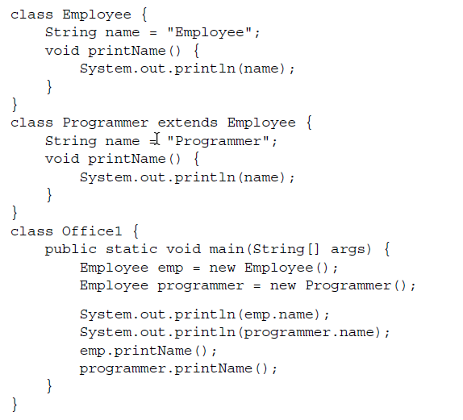
Binding at compile time vs binding at runtime: example
Notes:
Output is : Employee
Employee
Employee
Programmer

Slide 23
Binding at compile time vs binding at runtime: example
Output:
Employee
Employee
Employee
Programmer
Notes:
Output is : Employee
Employee
Employee
Programmer

Slide 24
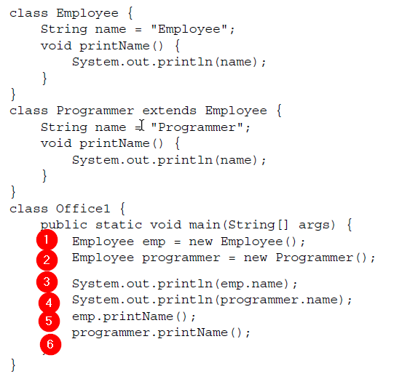
Binding at compile time vs binding at runtime: example
Notes:
creates new employee referenced by a variable of type Employee
creates new programmer referenced by a variable of type Employee
accesses the variable name and prints Employee
Because the variables are bound at compile time, the programmer.name will access the Employee
prints from Employee
prints from Programmer

Slide 25
QUIZ

Slide 26
Which of the following method signatures is a valid declaration of an entry point in a
Java application?
A. public void main(String[] args)
B. public static void main()
C. private static void start(String[] mydata)
D. public static final void main(String[] mydata)
Notes:
D. An entry point in a Java application consists of a main() method with a single String[] argument, return type of void, and modifiers public and static. The name of the variable in the input argument does not matter.
Option A is missing the static modifier,
Option B is missing the String[] argument
Option C has the wrong access modifier and method name.
Only Option D fulfills these requirements. Note that the modifier final is optional and may be added to an entry point method.

Slide 27
What is the proper filename extension for a Java bytecode compiled file?
A. .java
B. .bytecode
C. .class
D. .dll
Notes:
C. The proper extension for a Java compiled bytecode file is .class, making Option C the correct answer.

Slide 28
Which of the following is not a valid code comment in Java?
A. // Add 5 to the result
B. /*** TODO: Fix bug 12312 ***/
C. # Add configuration value
D. /* Read file from system ****/
Notes:
C. Java accepts Options A, B, and D as valid comments. Note that the /* */ syntax can have additional (and uneven) star (*) characters as shown in B and D.
Option C is incorrect as hashtag (#) is not a valid comment character in Java.

Slide 29
Which statement about a valid .java file is true?
A. It can only contain one class declaration.
B. It can contain one public class declaration and one public interface definition.
C. It must define at least one public class.
D. It may define at most one public class.
Notes:
D. A valid .java file may define any number of classes or interfaces but have at most one public class. It can also not define any public classes.
For these reasons, Option A, B, and C are incorrect, leaving Option D as the only correct answer.

Slide 30
Given the following class definition, which is the only line that does not contain a compilation error?
1: public ThisClassDoesNotCompile {
2: double int count;
3: void errors() {}
4: static void private limit; }
A. Line 1 // B. Line 2 // C. Line 3 // D. Line 4
Notes:
C. Line 1 is missing the class keyword.
Line 2 contains two types for the same variable.
Line 3 is a valid definition for a method, making C the correct answer.
Finally, line 4 contains an access modifier, private, after the return type, which is not allowed. In addition, void is an invalid type for variables.

Slide 31
Which of the following declarations does not compile?
A. double num1, int num2 = 0;
B. int num1, num2;
C. int num1, num2 = 0;
D. int num1 = 0, num2 = 0;
Notes:
A. Option A does not compile because Java does not allow declaring different types as part of the same declaration.
The other three options show various legal combinations of combining multiple variables in the same declarations with optional default values.

Slide 32
Which of the following is not a valid variable name?
A. _blue
B. 2blue
C. blue$
D. Blue
Notes:
B. An identifier name must begin with a letter, $, or _. Numbers are only permitted for subsequent characters. Therefore, Option B is not a valid variable name.

Slide 33
Which of the following is not a valid class declaration?
A. class building {}
B. class Cost$ {}
C. class 5MainSt {}
D. class _Outside {}
Notes:
C. Class names follow the same requirements as other identifiers. Underscores and dollar signs are allowed. Numbers are allowed, but not as the first character of an identifier. Therefore, Option C is correct. Note that class names begin with an uppercase letter by convention, but this is not a requirement.

Slide 34
Which best describes what the new keyword does?
A. Creates a copy of an existing object and treats it as a new one
B. Creates a new primitive
C. Instantiates a new object
D. Switches an object reference to a new one
Notes:
C. The new keyword is used to call the constructor for a class and instantiate an instance of the class. A primitive cannot be created using the new keyword. Dealing with references happens after the object created by new is returned.

Slide 35
Which of the following correctly assigns animal to both variables?
I. String cat = "animal", dog = "animal";
II. String cat = "animal"; dog = "animal";
III. String cat, dog = "animal";
IV. String cat, String dog = "animal";
Notes:
A. Option A (I) correctly assigns the value to both variables.
II does not compile as dog does not have a type. Notice the semicolon in that line, which starts a new statement.
III compiles but only assigns the value to dog since a declaration only assigns to one variable rather than everything in the declaration.
IV does not compile because the type should only be specified once per declaration.

Slide 36
Which of the following lines contains a compiler error?
String title = "Weather"; // line x1
int hot, double cold; // line x2
System.out.println(hot + " " + title); // line x3
A. x1
B. x2
C. x3
D. None of the above
Notes:
B. Java does not allow multiple Java data types to be declared in the same declaration,making Option B the correct answer.
If double was removed, both hot and cold would be the same type.

Slide 37
Which of the following lists of primitive numeric types is presented in order from smallest to largest data type?
A. byte, short, int, long
B. int, short, byte, long
C. short, byte, int, long
D. short, int, byte, long
Notes:
A. These four types represent nondecimal values. While you don’t need to know the exact sizes, you do need to be able to order them from largest to smallest.
A byte is smallest.
A short comes next, followed by int and then long. Therefore, Option A is correct.

Slide 38
What is the output of the following application?
package planning;
public class ThePlan {
public static void main(String[] input) {
int plan = 1;
plan = plan++ + --plan;
if(plan==1) {
System.out.print("Plan A");
} else { if(plan==2) System.out.print("Plan B"); }
else System.out.print("Plan C");
}
}
A. Plan A
B. Plan B
C. Plan C
D. None of the above
Notes:
D. None of the above

Slide 39
What is the value of thatNumber after the execution of the following code snippet?
long thatNumber = 5 >= 5 ? 1+2 : 1*1;
if(++thatNumber < 4)
thatNumber += 1;
3
4
5
The answer cannot be determined until runtime.
Notes:
B. The initial assignment of thatNumber follows the first branch of the ternary expression.
Since 5 >= 5 evaluates to true, a value of 3 is assigned to thatNumber. In the next line, the
pre-increment operator increments the value of thatNumber to 4 and returns a value of 4 to
the expression. Since 4 < 4 evaluates to false, the if-then block is skipped. This leaves the
value of thatNumber as 4, making Option B the correct answer.

Slide 40
What will be printed in the console
package schedule;
public class PrintWeek {
public static final void main(String[] days) {
System.out.print(5 +” 6 “+ 7 + 8 + 9);
}
}
A. 56789
B. 11789
C. 11717
D. The code does not compile.
Notes:
A.

Slide 41
Which type of loop is guaranteed to have the body execute at least once?
A. do-while loop
B. for (traditional)
C. for-each
D. while
Notes:
A. A do-while loop checks the loop condition after execution of the loop body. This ensures it always executes at least once, and Option A is correct. Option B is incorrect because there are loops you can write that do not ever enter the loop body, such as for (int i=0;i<1;i++). Similarly, Option D is incorrect because a while loop can be written where the initial loop condition is false. Option C is incorrect because a for-each loop does not enter the loop body when iterating over an empty list.

Slide 42
What is the result when we run this code
int singer = 0;
while (singer)
System.out.println(singer++);
A. 0
B. The code does not compile.
C. The loops complete with no output.
D. This is an infinite loop.
Notes:
B. A while loop requires a boolean condition. While singer is a variable, it is not a boolean. Therefore, the code does not compile, and Option B is correct.

Slide 43
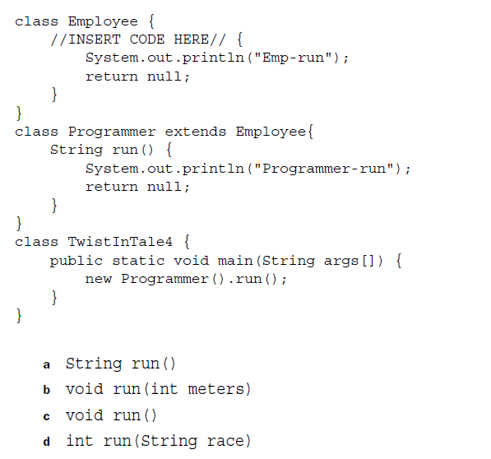
Practice: what should be inserted in //INSERT CODE HERE// so that we could state that the method run() is accessed polymorphically?
Notes:
Answer is a.

Slide 44
Întrebări, sugestii, propuneri

